Slide 1

Extracting valuable knowledge from Axon's data on car sales.

Slide 2
Agenda
Achievements and Notable Events
Overview of Sales Operations
Synopsis of Key Performance Metrics
Fresh Sales Targets

Slide 3



We gained 74 new customers.
We have 39 repeat customers.
1992 Ferrari 360 Spider red is top performing product

Slide 4
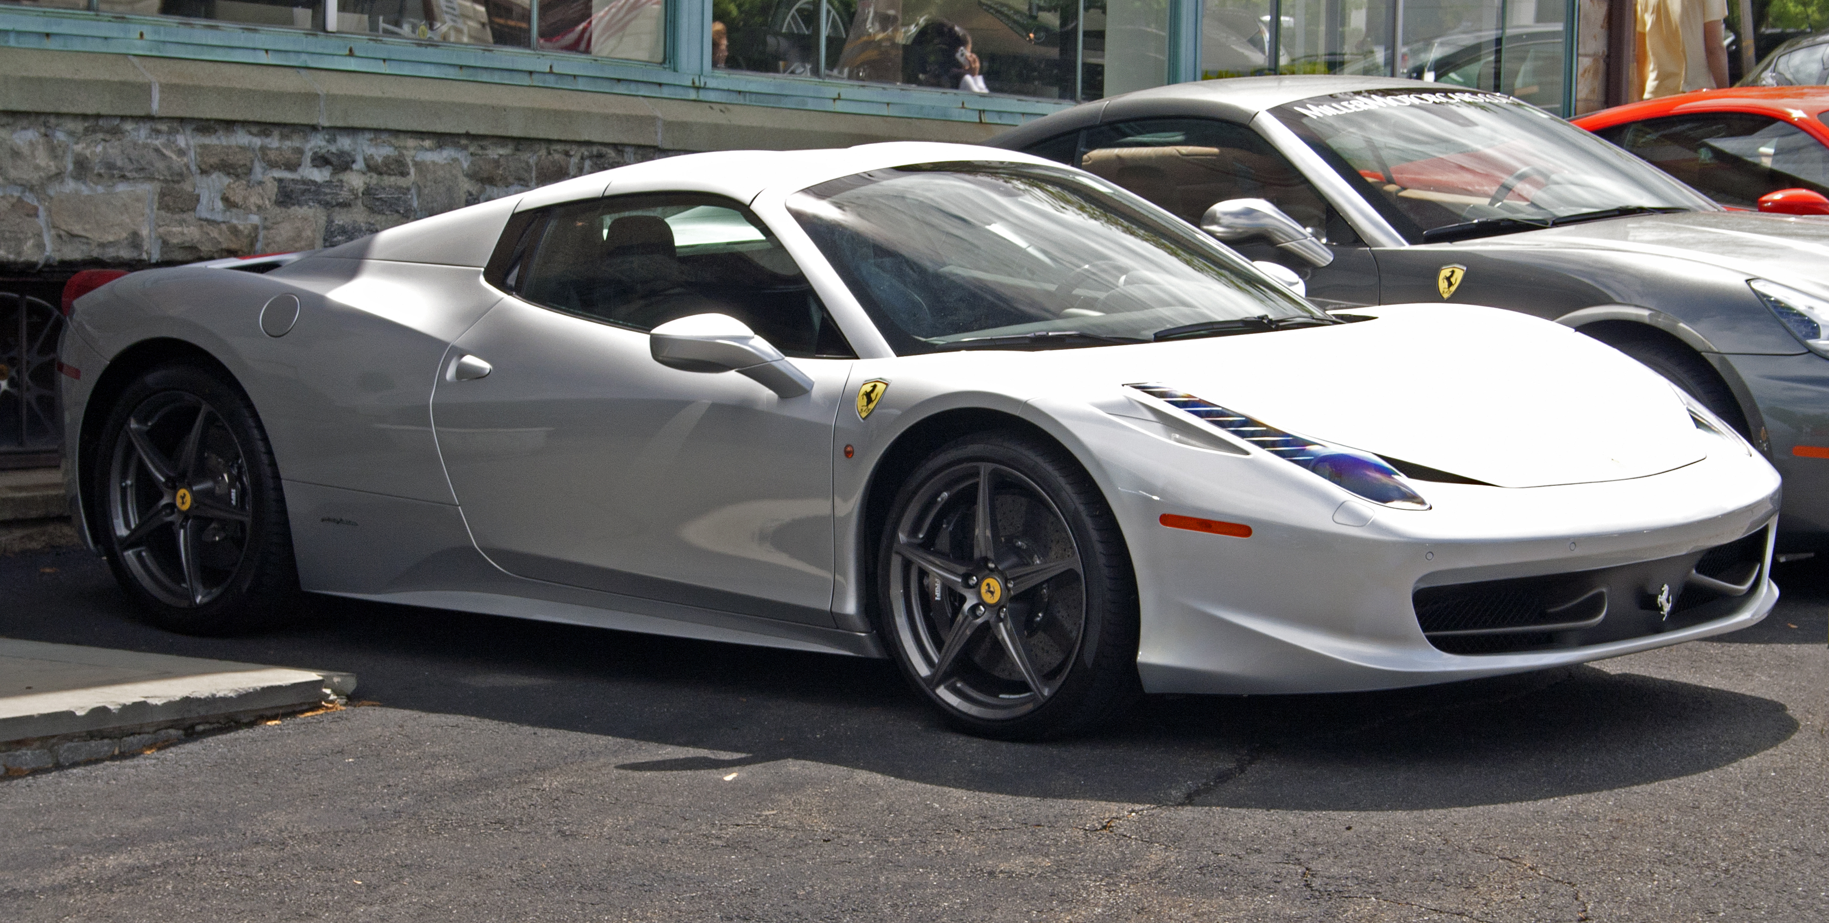
Overview of Sales Operations

Slide 5
Sales Performance by Country
USA has highest total sales of $835.45K followed by $260.93K of Spain
Sales Growth Rate Analysis
Sales growth rate of 10.33 over 3 years has been observed.
Sales Performance by Car Model
1992 Ferrari 360 Spider red is top performing product having total sale of $276.84K followed by 2001 Ferrari Enzowhich has total sales of $190.76K.

Slide 6
Synopsis of Key Performance Metrics
New Customers 74
Newly acquired customers YTD goal : 109 (31.97 retained customers + 10% growth), and as we already have 74 new customers, we would need to acquire an additional 109 -74 = 35 new customers.

Slide 7
Revenue of current period
Compared to the previous year, 2005 saw a $8.76 M decrease in revenue.

Slide 8
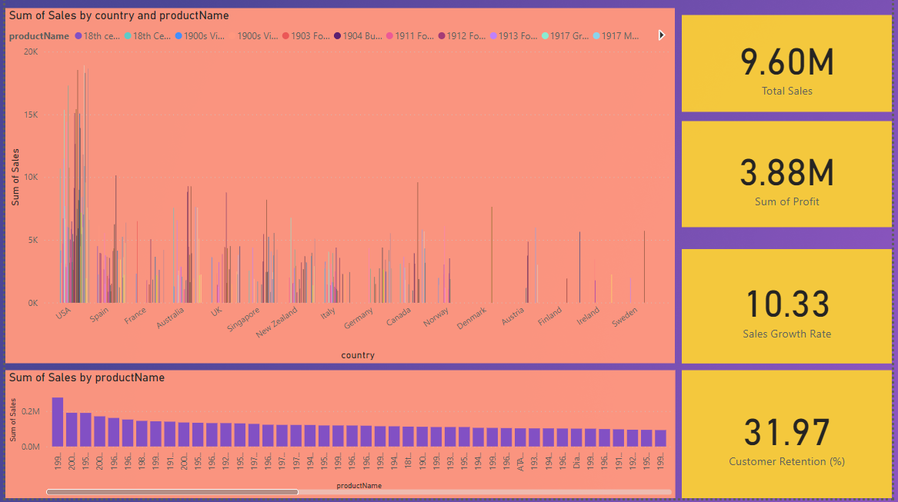
With profit of 3.88M, Average daily Sales volume is 123.27 and customer retention of 31.97%

Slide 9
Fresh Sales Targets
Sales target of 10~(Sales Target=Previous Year Revenue−Revenue Difference =9.96), with target sales rate would be approximately 87.3% by the end of the calendar year
Increase the customer base by acquiring 35 new customers by the end of year

Slide 10
Upcoming steps

Slide 11
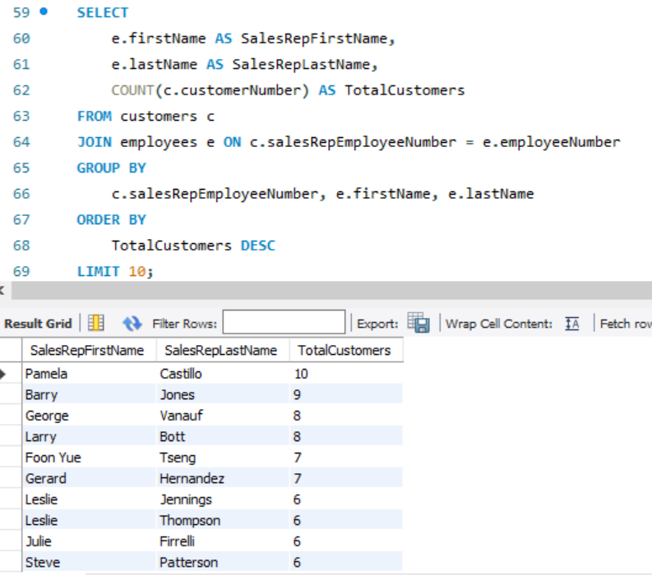
Sales team helping company to reach goals

Slide 12
Thank you

